Slide 1
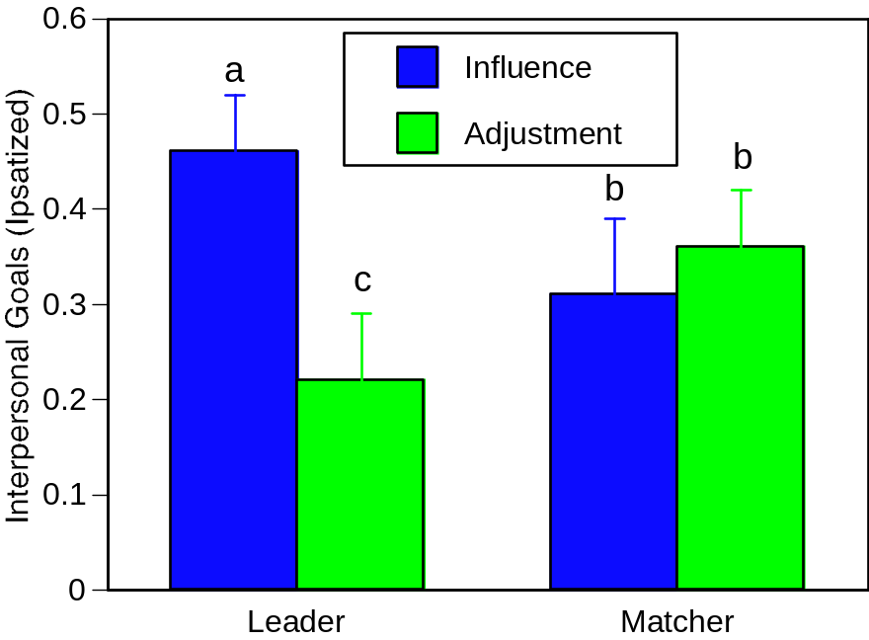
Across Groups, Leaders Value Influence More and Adjustment Less Than Matchers
Partner X Goal Type: F(1,47) = 26.55, p <.001

Slide 2
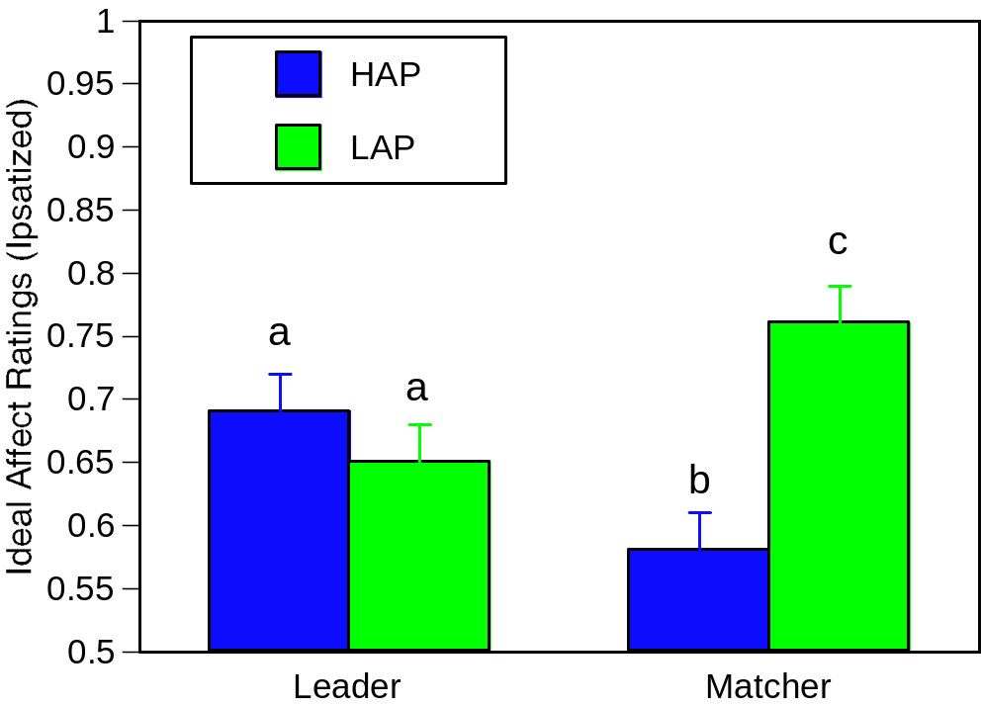
Across Groups, Leaders Value HAP More and LAP Less Than Matchers
Role X Affect Type: F(1,47) = 6.47, p <.05

Slide 3
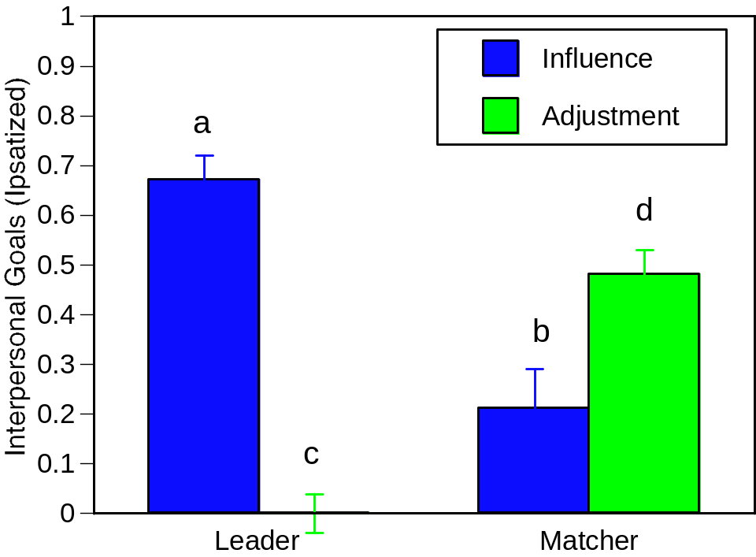
Across Trials and Groups, Leaders Value Influence More and Adjustment Less Than Matchers
Role X Affect Type: F(1,27) = 65.55, p <.001

Slide 4
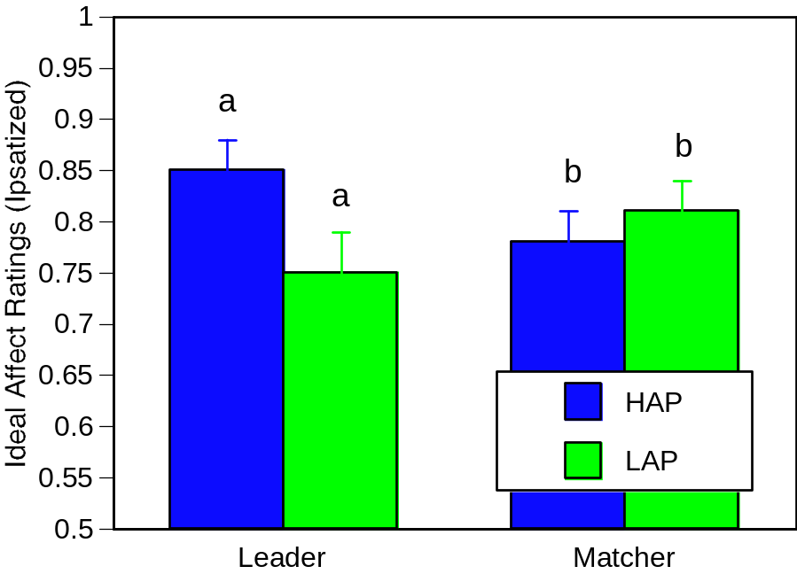
Across Trials and Groups, Leaders Value HAP More and LAP Less Than Matchers
Role X Affect Type: F(1,27) = 5.49, p <.05

Slide 5
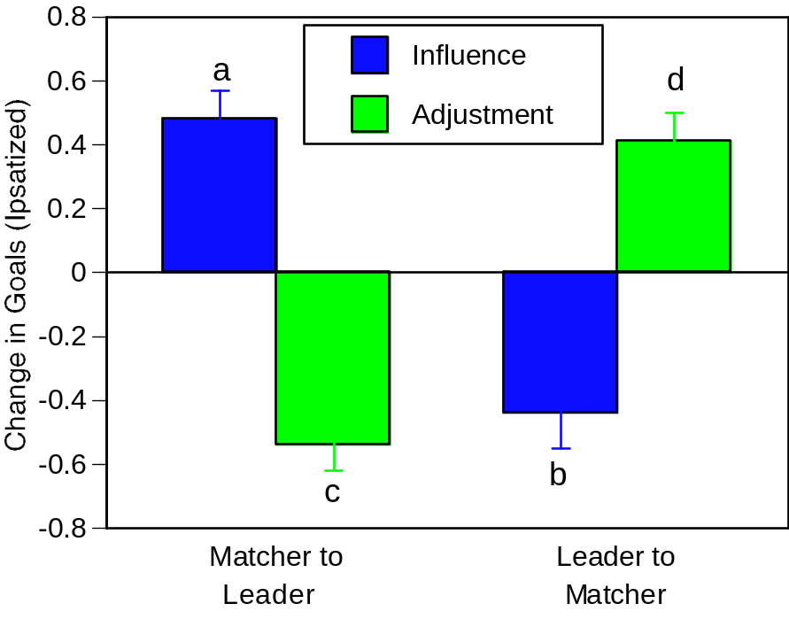
Across Groups, Change in Roles Results in Change in Influence and Adjustment Goals
Role X Affect Type: F(1,27) = 65.55, p <.001

Slide 6
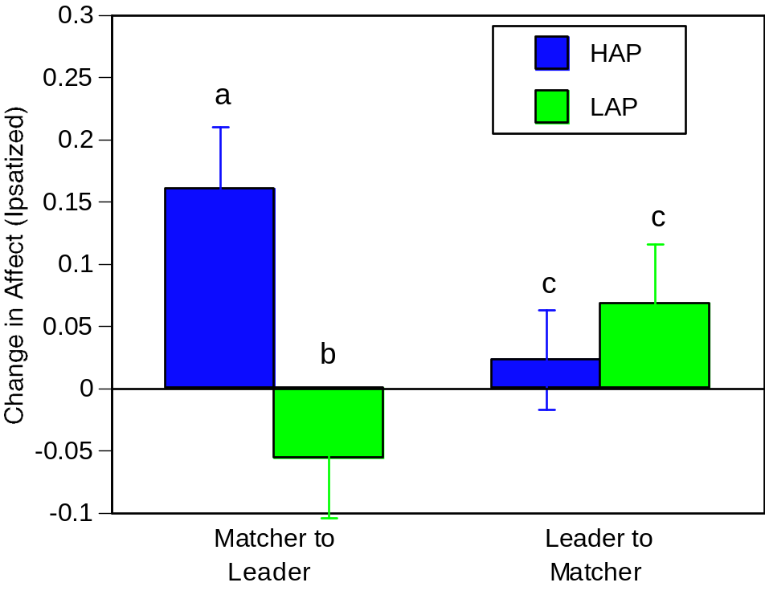
Across Groups, Changes in Roles Result in Changes in Ideal Affect
Role X Affect Type: F(1,27) = 5.49, p <.05

